Slide 1
Data-driven Visualizations

Slide 2
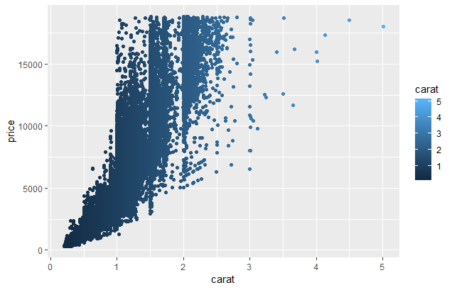
What is effective about this? What is not?

Slide 3
What is effective about this? What is not?
Effective
No optical illusions
Not effective
Extraneous grid lines
Unnecessary color
Accessibility: shading contrast not good
Accessibility: font sizes (presentations vs manuscripts)

Slide 4
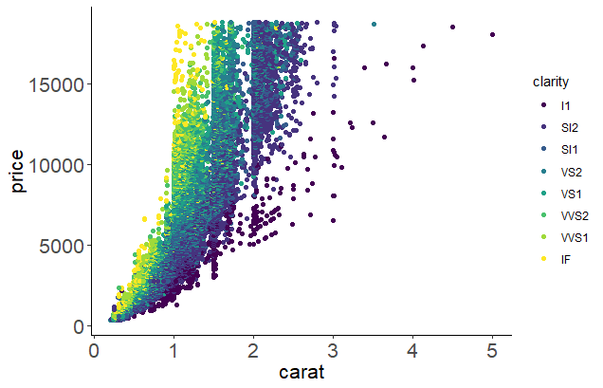
What is effective about this? What is not?
Effective
Increased data density (information per unit area) with colors
Data/ink ratio: maximize use of ink for data
No optical illusions
Accessibility: color blind color choices
Improvements
Removed grid lines
Made color a different grouping variable
Increased font size for readability

Slide 5
What is effective about this? What is not?
What else could we do?
Change color grouping to grayscale or test in grayscale
Increase legend size
Explain clarity is and if it has an ordering
For a presentation, rotate y-axis label to horizontal
Add commas (or periods in Europe) to large numbers if domain- or journal-specific allows

Slide 6
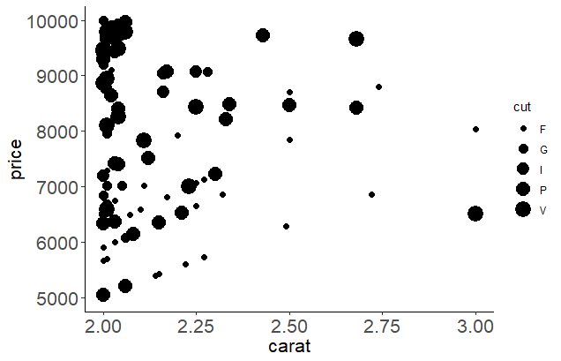
What is clear or misleading about this?

Slide 7
What is clear or misleading about this?
Clear
Chart design consistent throughout
Units appropriate
Not clear
Symbols and axes proportional to numbers represented (problem with pie charts, area in general)
Lack of context: did not show all relevant data
Clear labels (minimize abbreviations)

Slide 8
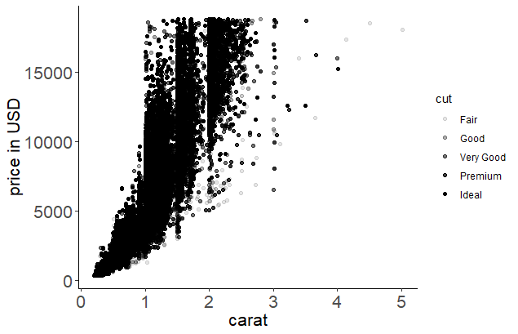
What is clear or misleading about this?
Clear
Chart design consistent throughout
Units appropriate
Improvements
Removed area-cut relationship
Lack of context: did not show all relevant data
Lack of context: units for y-axis added
Clear labels – not abbreviated

Slide 9
Please take 3 min to help us improve
Survey link:
Today’s topic: Data-driven visualizations
Notes:
For those who didn’t bring a device, offer to email them via EventBrite

Slide 10
Find more resources and upcoming events!
Impact Challenge https://libraries.ou.edu/ impactchallenge
Feb 4-8: Make your data discoverable
Feb. 11-15: Share software with Github
Feb. 18-22: Understand DOIs
Carpentries two-day workshops https://libraries.ou.edu/ carpentries
Digital Skills Hub – Coming Soon! https://digitalskills.oucreate.com
Information Specialists @ DAVIS https://libraries.ou.edu/davis
Digital Scholarship Lab https://libraries.ou.edu/dsl

